Slide 1
ADOBE ANALYTICS WORKSPACE

Slide 2

WALT DISNEY Trades Products/Parks - Customer Sentiments
We trust Walt Disney’s emotional connect with the sentiments of the customers as majority functions are related to small children and their parents. So it is important to deliver the best experience to all Disney Fans/Customers.
Key Objective
To enhance the overall experience for Disney fans and connect to their sentiments by socializing on a global level.
Moreover, to provide a user friendly platform for the mobile and desktop users in order to achieve a convenient shopping environment.

Slide 3
THREE KEY FACTORS THAT AFFECT DISNEY SHOPPING
First time visitors and purchasers.
Purchase flow on mobile vs desktop.
Web Average Order Value.

Slide 4
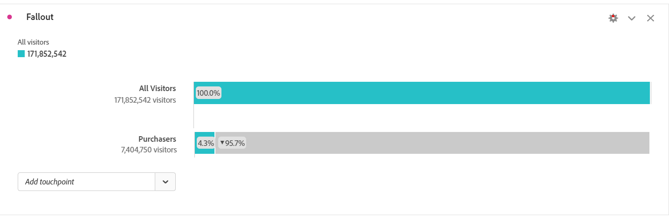
How do first time visitors affect Disney?
We noticed that , from a total of 172M people, visiting for the first time, only 7.4M people purchase from the website, i.e. about only 4.3% of the first time visitors make a purchase. So how do we get the customers to make a subsequent purchase or a return visit?

Slide 5
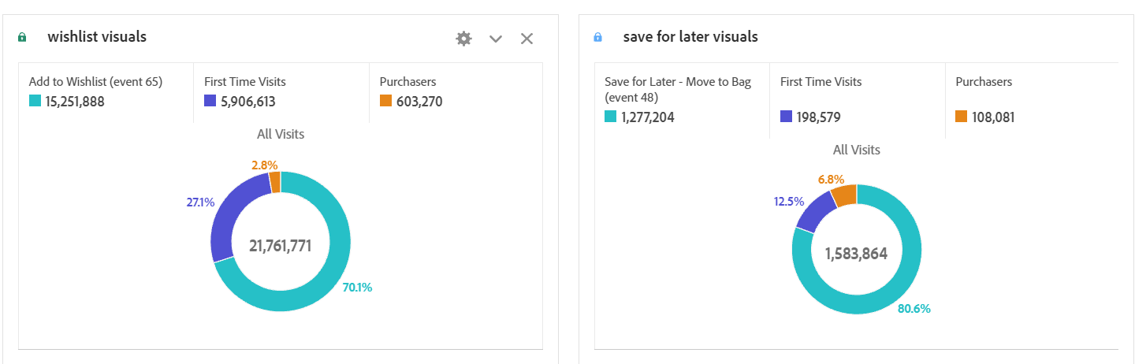
DATA STATUS
From the data provided, the most indicative behaviors for a subsequent purchase are:
A. “ADD TO WISHLIST” B. “SAVE FOR LATER”
As we observe, more percentage of people use “add to wish list” as compared to “save for later”.
Contradictorily, the percentage of people who purchase from the latter are more. This is due to the
layout of the cart and product detail page.

Slide 6
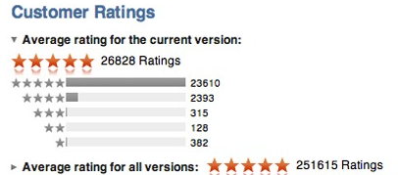


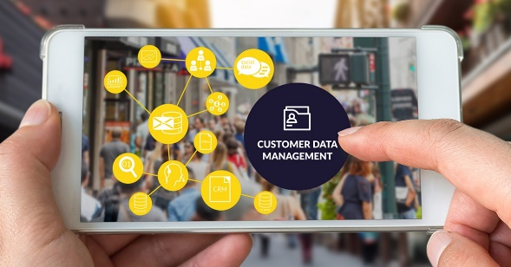
HOW TO ENCOURAGE REPEAT PURCHASES?
Provide and analyze customer ratings to get knowledge about the customers who will return in order to target them.
Continue to engage with targeted post-purchase messaging.
Incentivize a second purchase by providing discounts, offers and promo codes fore the first time buyers.
Optimize product suggestions by keeping a track on the products the consumer is most interested in .
Deploy retargeting the audience who abandon their carts by sending out messages like “Few left” or “Save upto” to increase conversions.
SO HOW DO THESE FACTORS MAKE AN IMPACT ON THE PURCHASE FLOW ON MOBILE VS DESKTOP?
SO HOW DO INCREASE IN SUBSEQUENT PURCHASES MAKE AN IMPACT ON THE PURCHASE FLOW ON MOBILE VS DESKTOP?

Slide 7
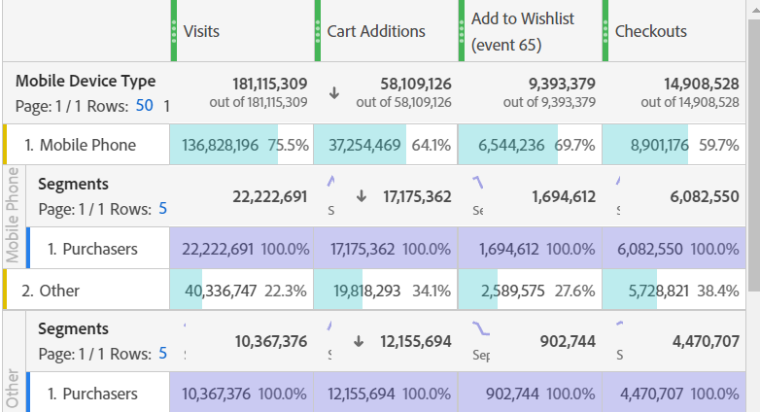
ANALYSIS OF PURCHASE FLOW ON MOBILE VS DESKTOP
It is noted that, if a user adds product to cart there is 49.8% chance that the user will purchase it, which is increased by 29% if the user adds it to the wishlist before purchasing. Additionally, if a customer reaches “checkouts” page, there is 71.4% chance of a purchase.
Considering overall visits, as seen earlier, visitors through mobile are more than the visitors on desktop. Yet, looking at our purchase ratio, mobile users’ ratio sum upto 16.3% while desktop users’ make around 25.8% which is seemingly larger than the former observation.
DIFFERENCES BETWEEN PURCHASE FLOW ON MOBILE VS DESKTOP

Slide 8
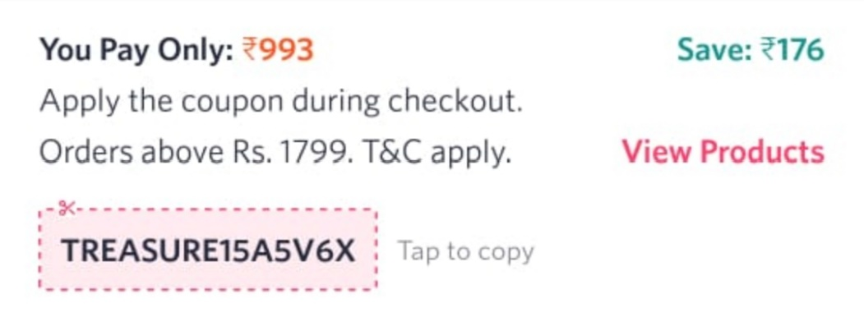
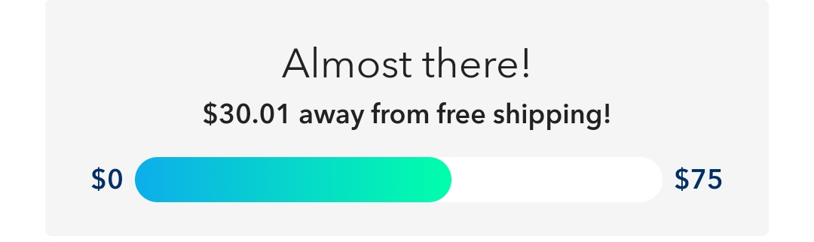
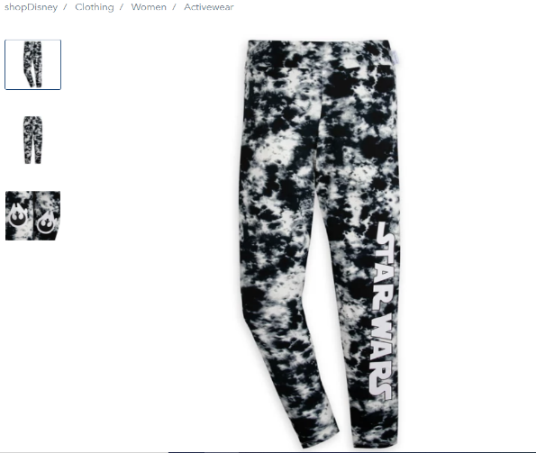
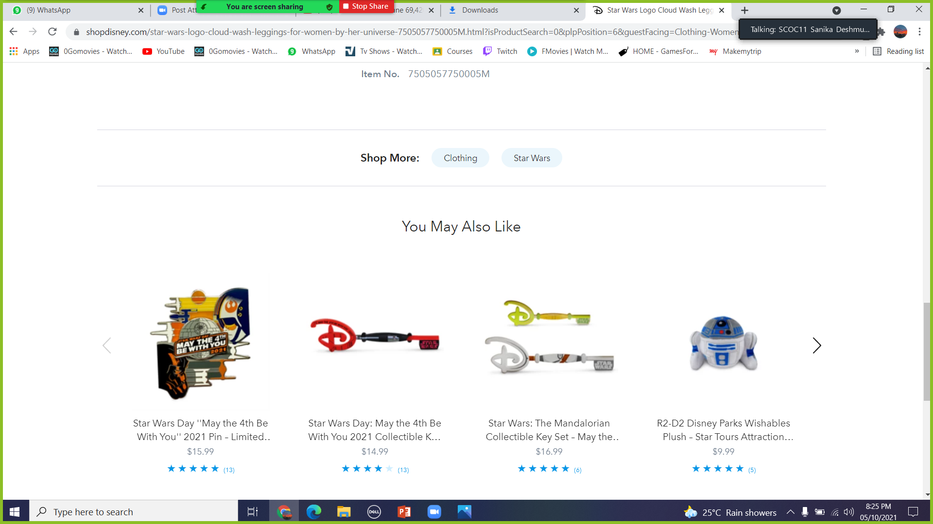
IMPROVISATIONS TO BE DONE FOR DISNEY-WEB ON MOBILE VS DESKTOP
“Offers & Promo code” segment to be added on Product Detail Page along side with the cart to bring the attention of “unsure” customers .
Deploy smaller and fewer menus on the mobile as it is found through surveys that mobile users enjoy it when there are fewer menus to jump to a particular product.
“Free shipping for orders upto $75” segment to be added on the desktop (already present on mobile) to encourage the consumers to buy more products in an attempt to get free shipping.
“You may also like” suggestions should be
similar to the category the user is
searching, which is not found on
most products.

Slide 9
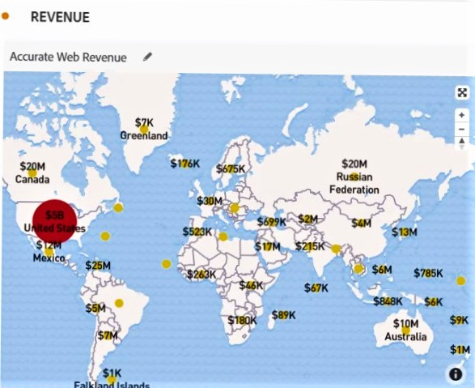
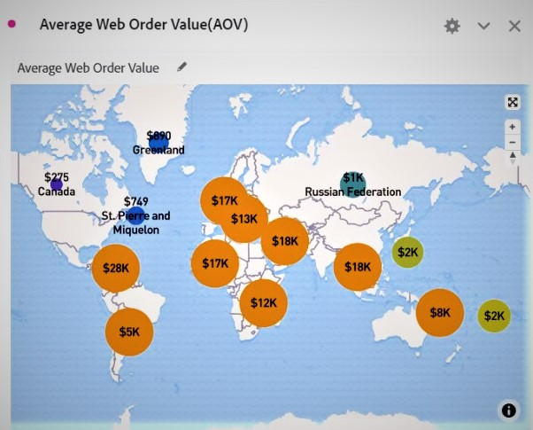
LET US NOW DIVE INTO THE DEEP OCEAN OF REVENUE AND WEB AVERAGE ORDER VALUE (AOV)
There is no doubt that the major chunk of a revenue is gained from USA which leads to paying close attention to the people of USA and connect them through emotions and sentiments.
Walt Disney cannot stop only at USA.
As observed most of the part of the world is not contributing in Disney, therefore,
to shift more focus to the rest of the world is equally challenging and vital.

Slide 10
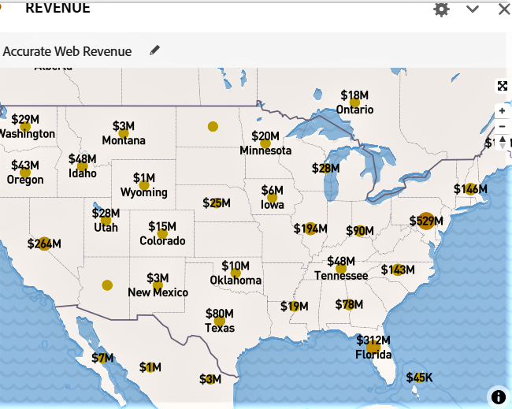
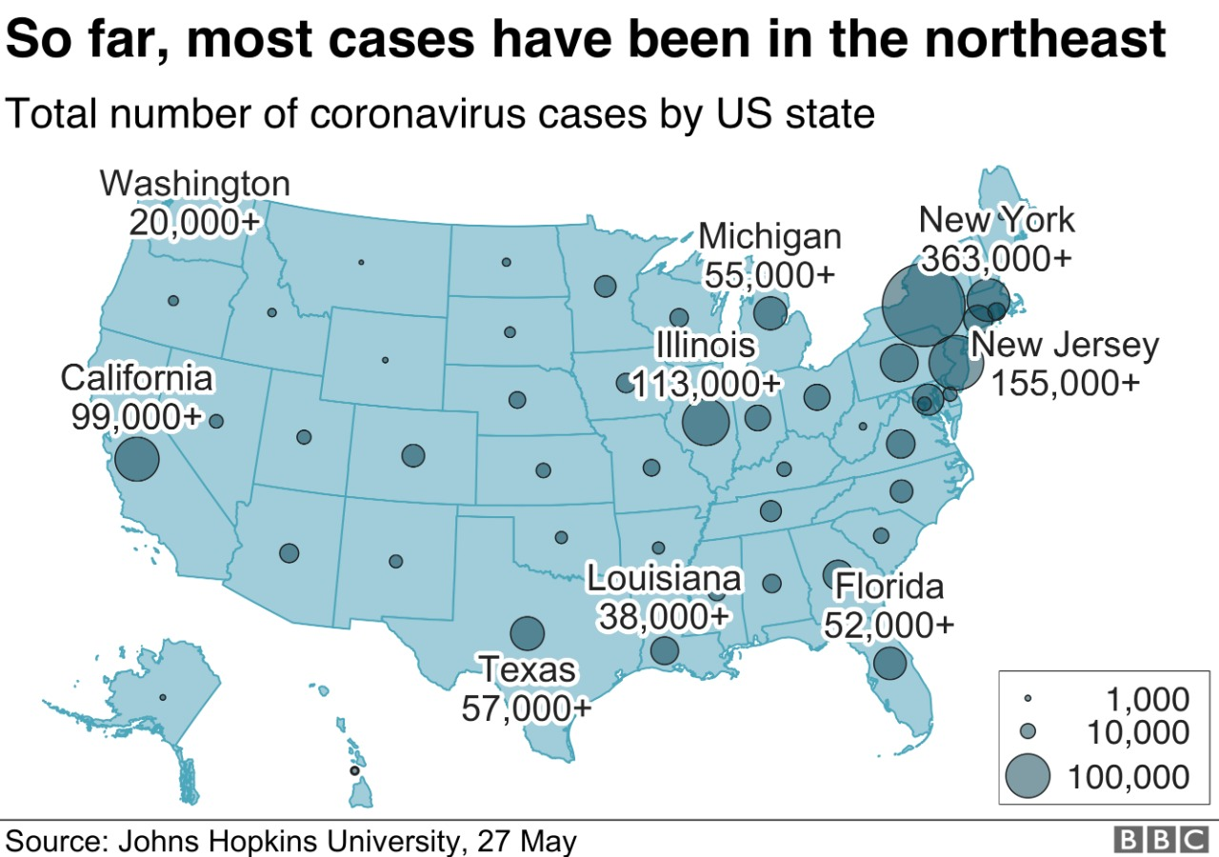
FACTS and FIGURES
As compared to the year 2019, the total revenue of Walt Disney has faced a major downfall in 2020 as the states that provide the highest revenue are the most
COVID 19 (Temporary Threat) hit states in USA;
which collapsed the Disney theme parks, resorts and vacations and reduces revenue from $17.23B in 2019 to $13.23B in 2020.
On the other hand, shockingly we saw a major boost in the revenue collection of Disney Merchandise.

Slide 11
Scrutiny of Disney Web Average Order Value over a period of time.
In order to study AOV we have divided the time period into 3 major intervals
For better understanding these intervals are further broken-down in 3 types of months
9 Months before Covid (From August 2019 to April 2020)
1st 9 Months During Covid (From May 2020 to January 2021)
2nd 9 Months during Covid without MSM (From February 2021 to Early September 2021)
Most Seasonal months (MSM)
October
November
April
June
Non Seasonal Months (NSM)
January
February
December
May
March
July
August
September
Less Seasonal Months (LSM)
Web Average Order Value
(AOV)
Most Seasonal Months
(MSM)
Less Seasonal Months
(LSM)
Non Seasonal Months
(NSM)

Slide 12
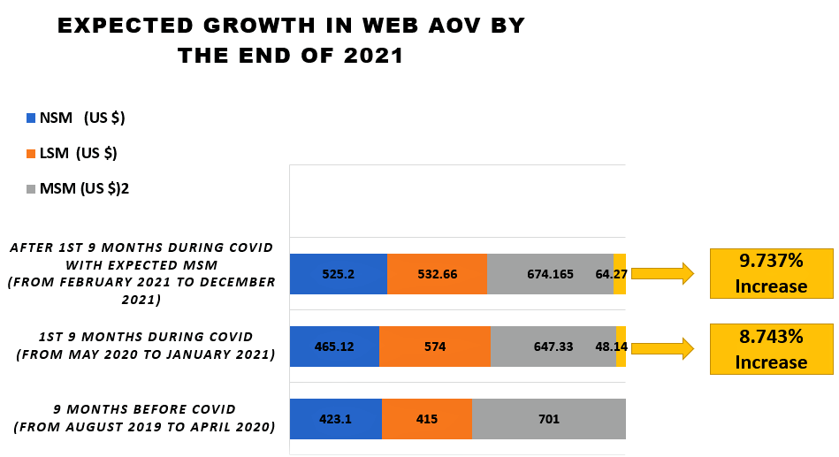
ANALYSING THE DEPTH Web AOV over a given period of time.

Slide 13
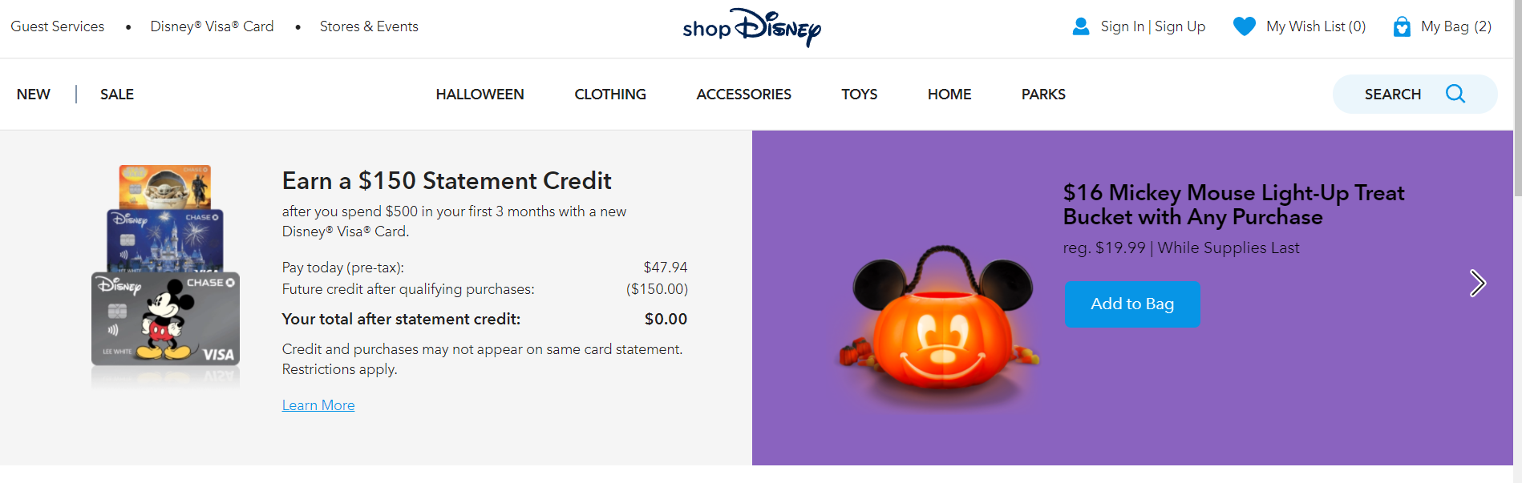
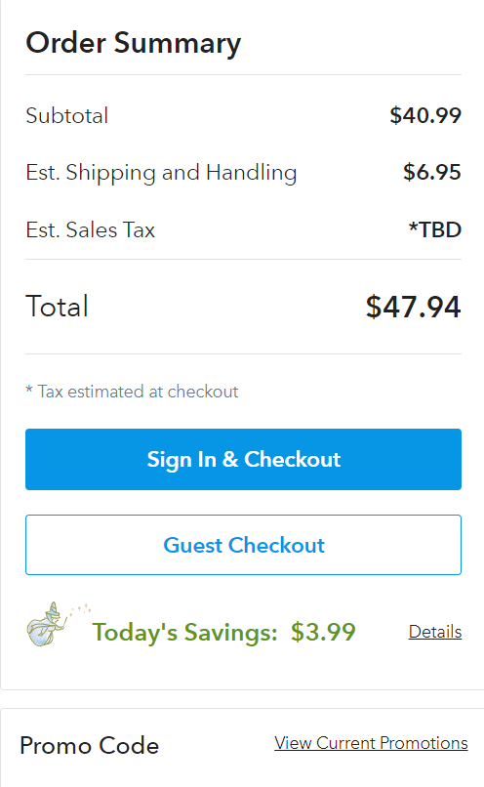

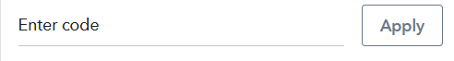
Suggestions for the IMPROVISATION in a CART/BAG of DISNEY MERCHANDISE (DESKTOP)
Should be removed from the Cart.
(Causes major distraction while a purchase)
Order Summary and Promo Code should be interchanged in the position as majority purchases are done after the application of a Promo Code.
Free shipping bar MISSING. Its important as about 55% people tend to purchase a product and is more convincing for customer to buy a product. (Already present in Mobile)

Slide 14
THANKYOU

Slide 15
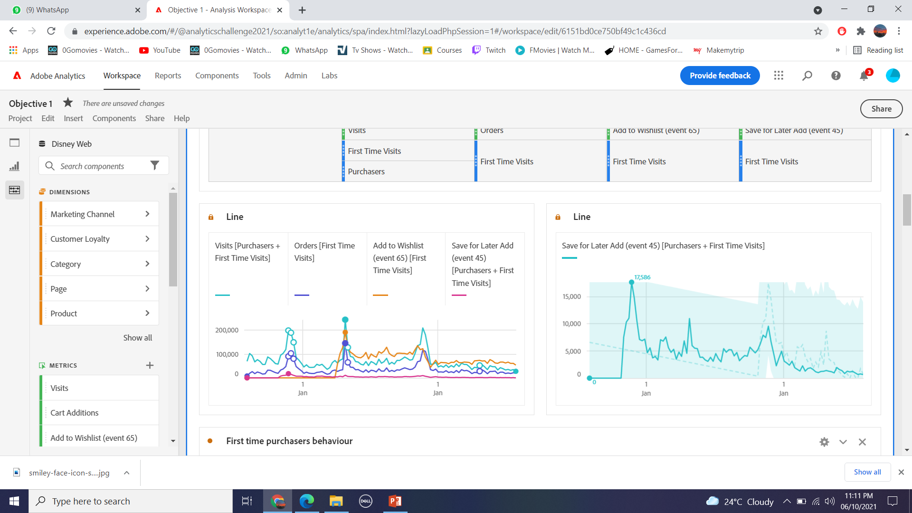
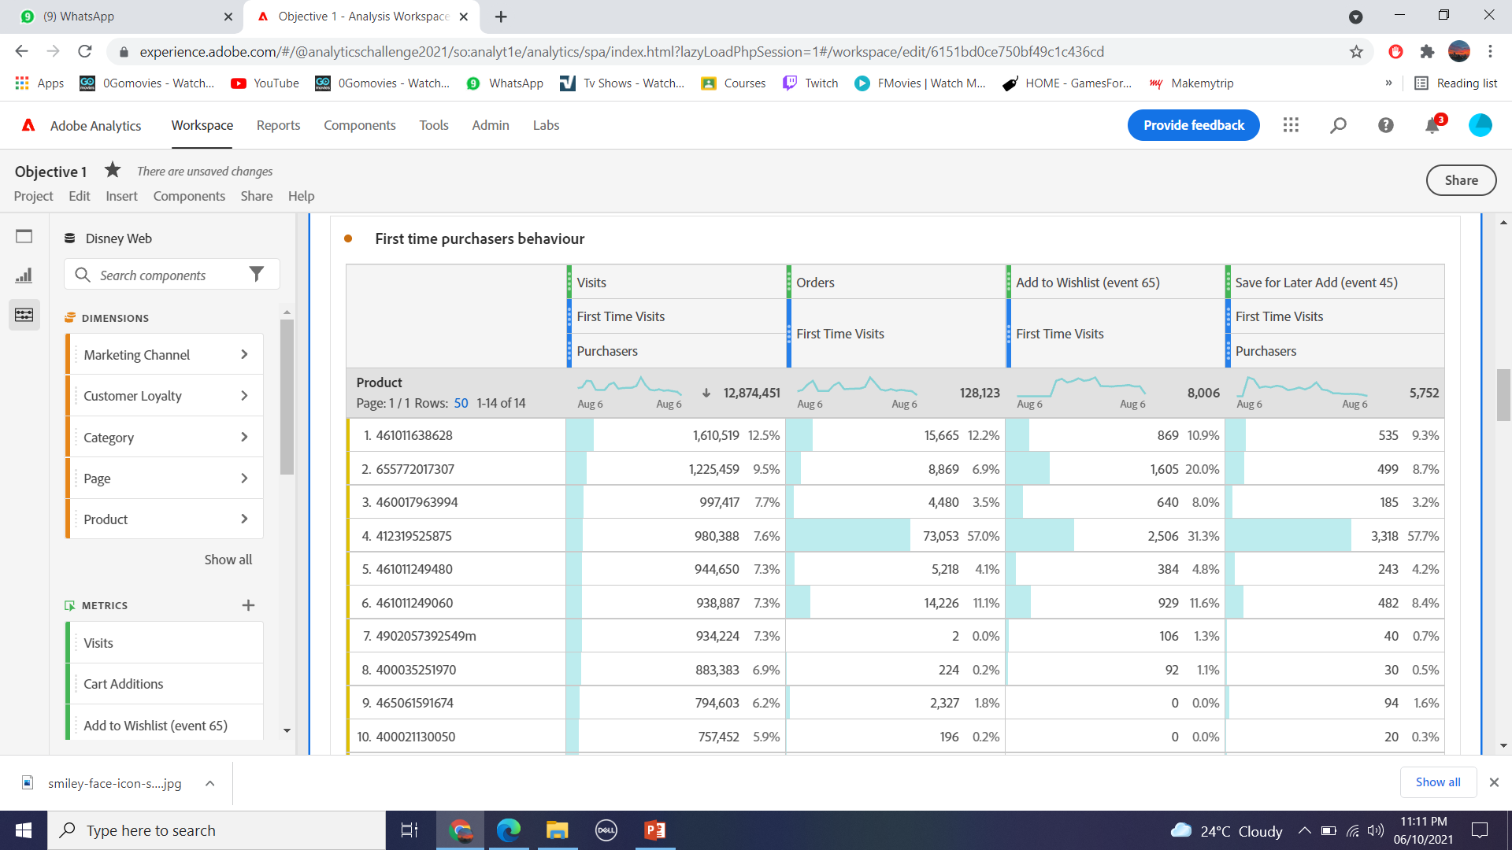
APPENDIX
(ONLY FOR REFERENCE;NOT INCLUDED IN PPT)
OBJECTIVE 1 DATA ANALYSIS

Slide 16
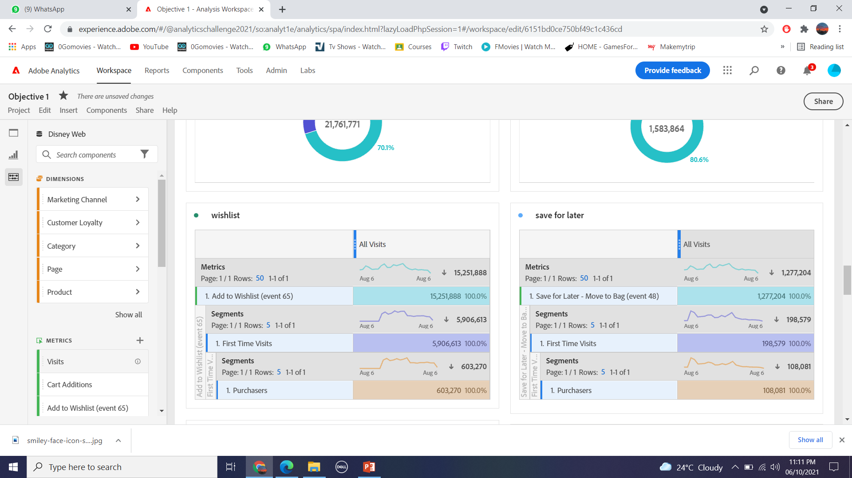

Slide 17
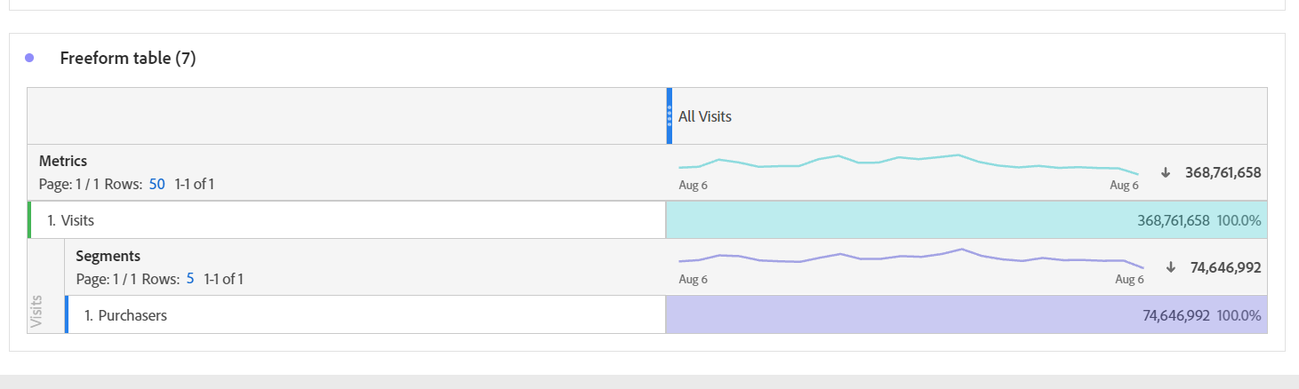
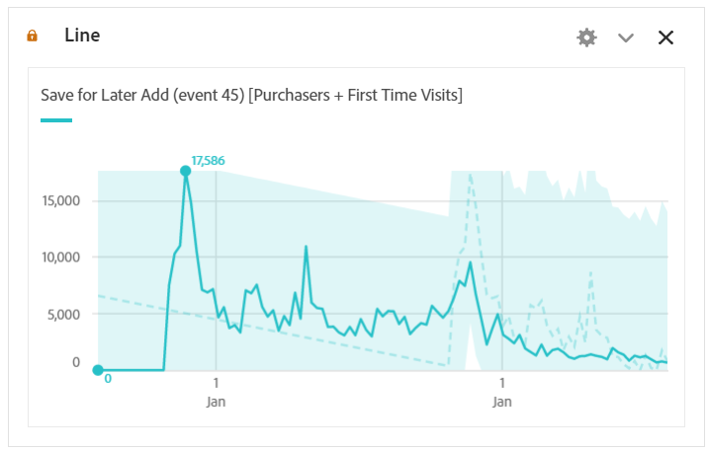

Slide 18
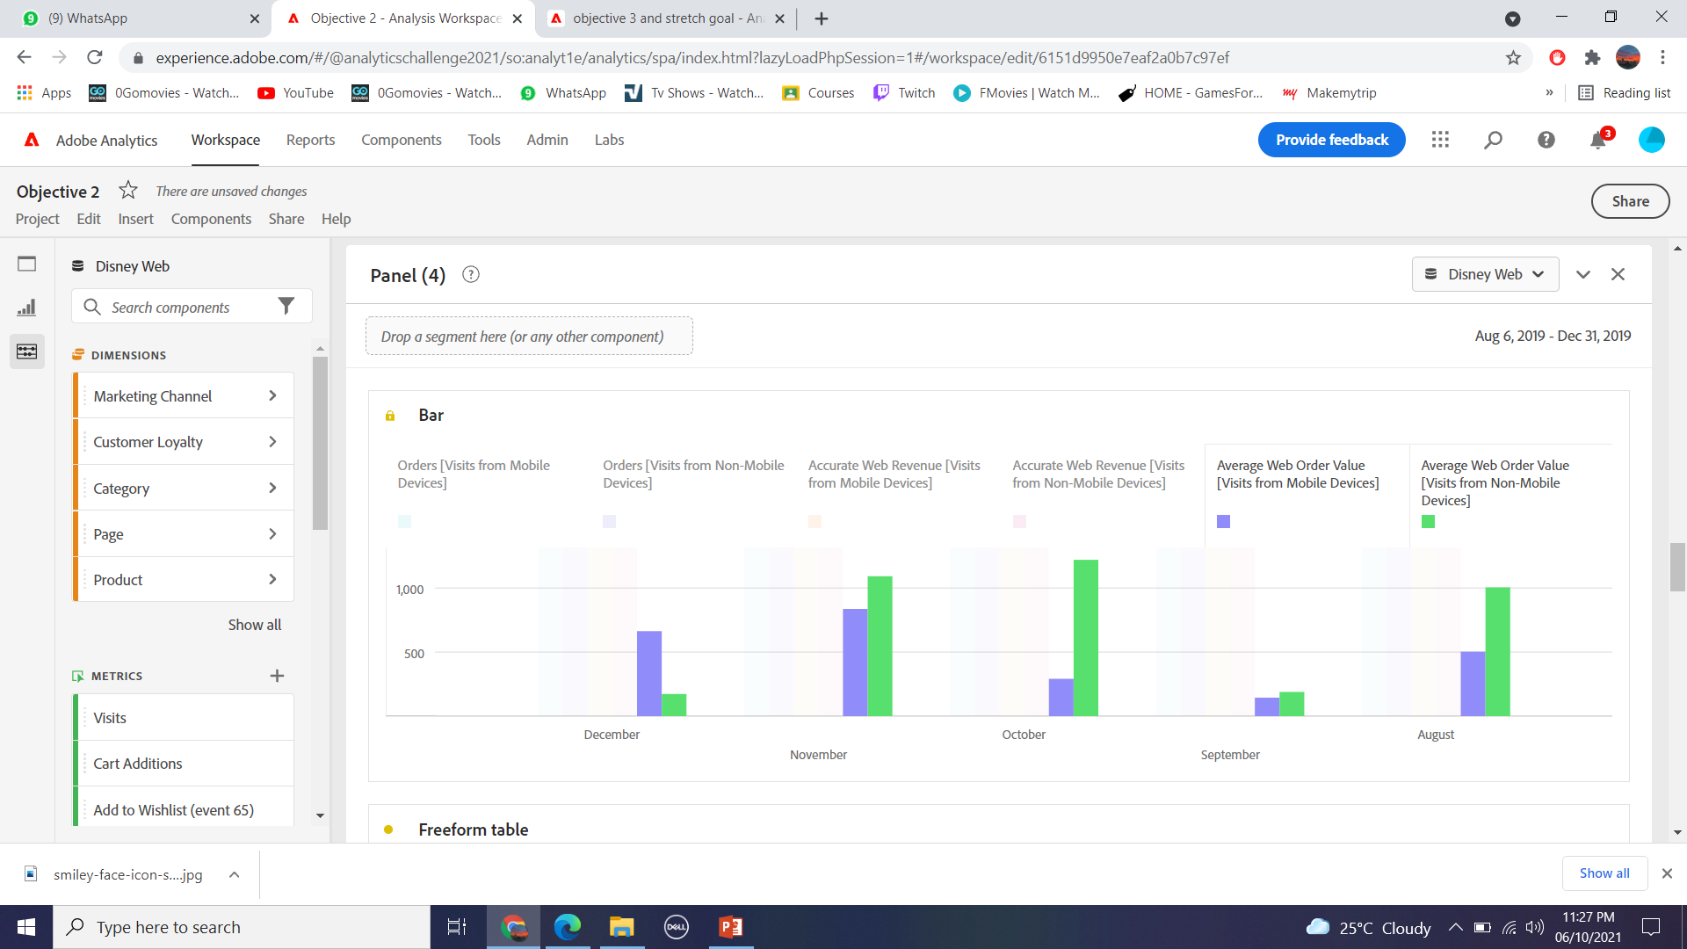
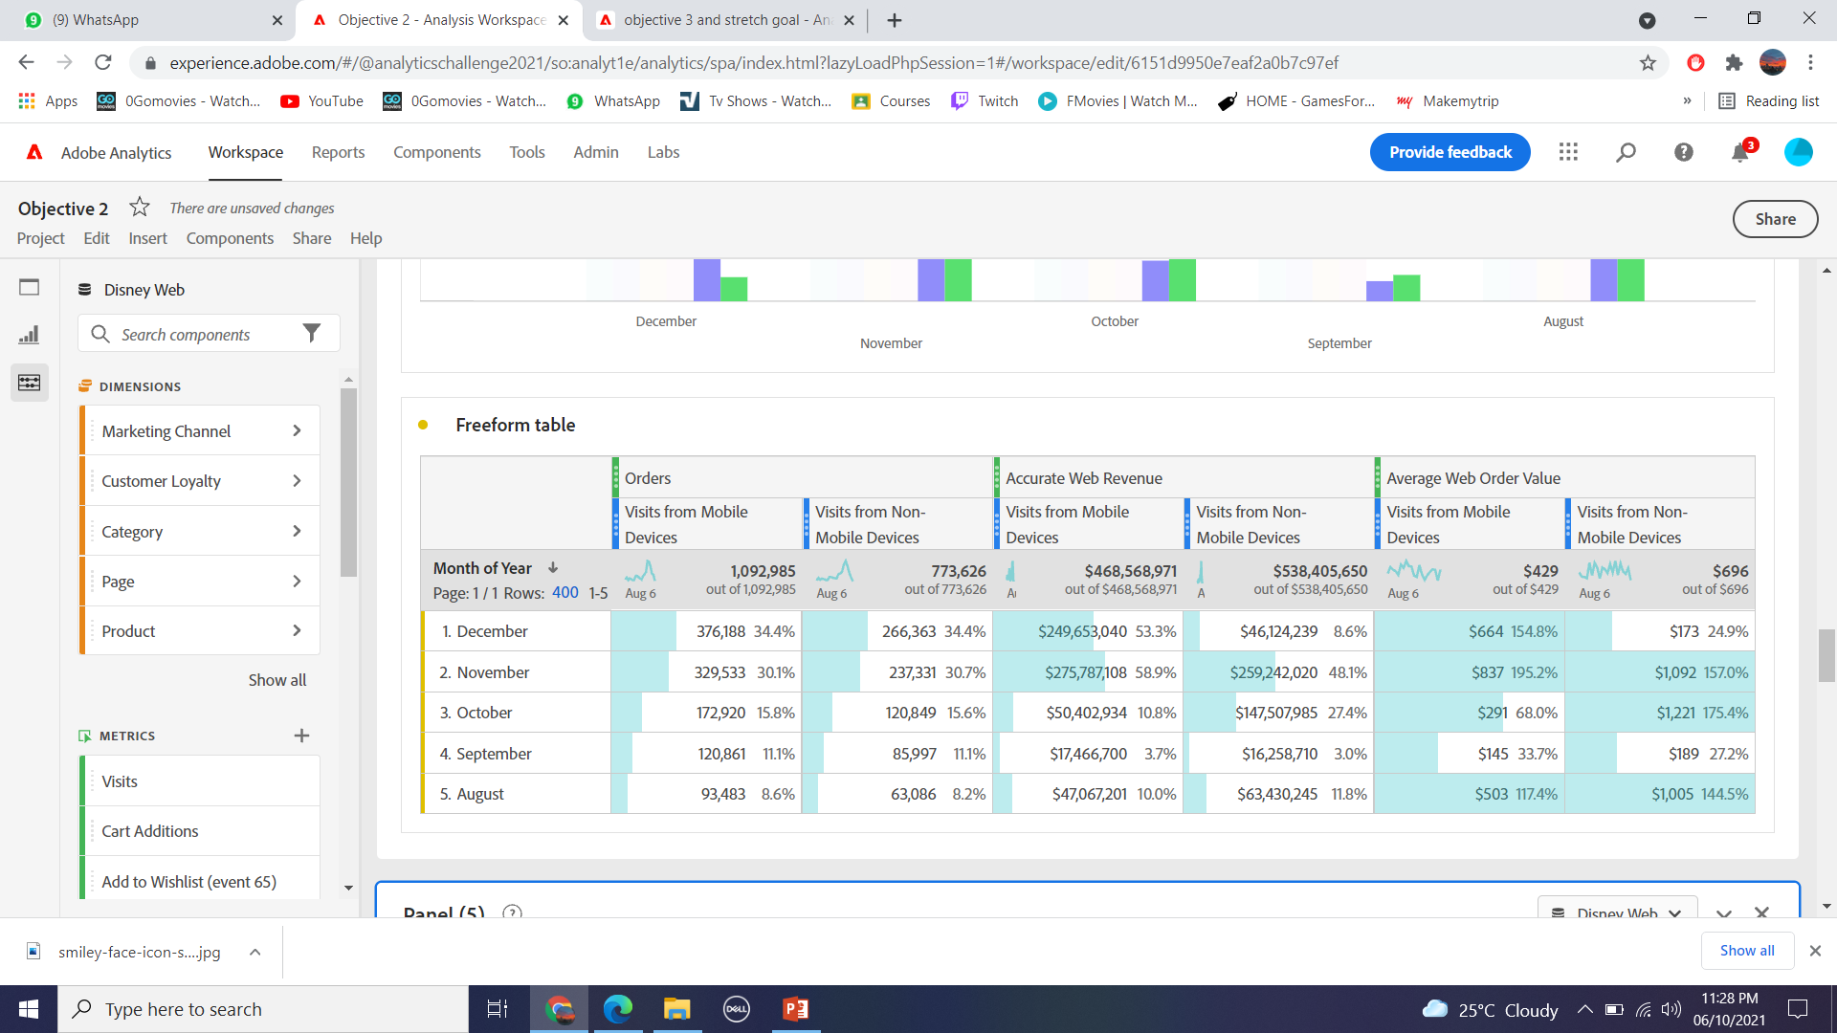
OBJECTIVE 2 DATA ANALYSIS

Slide 19
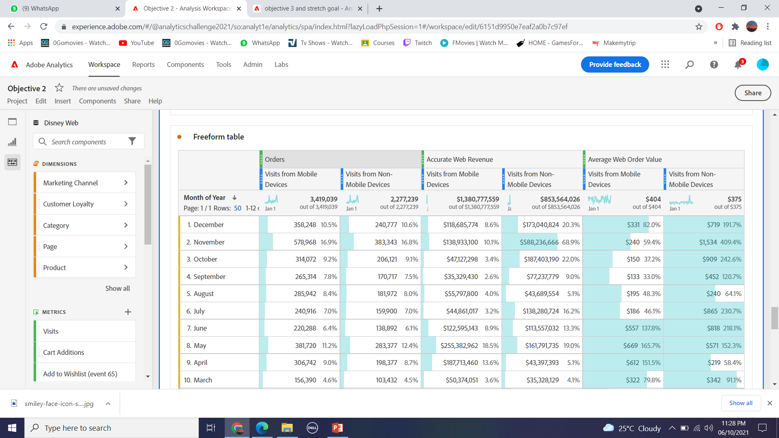
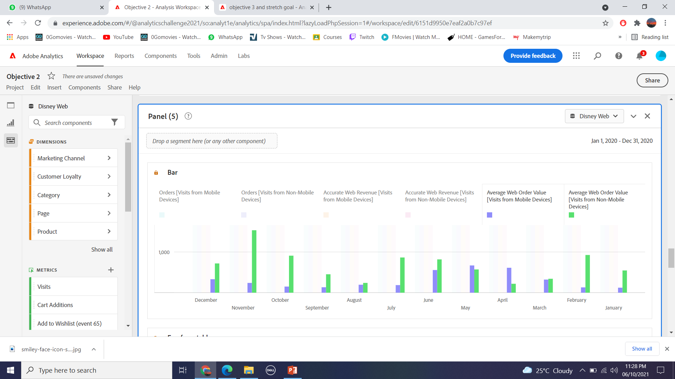

Slide 20
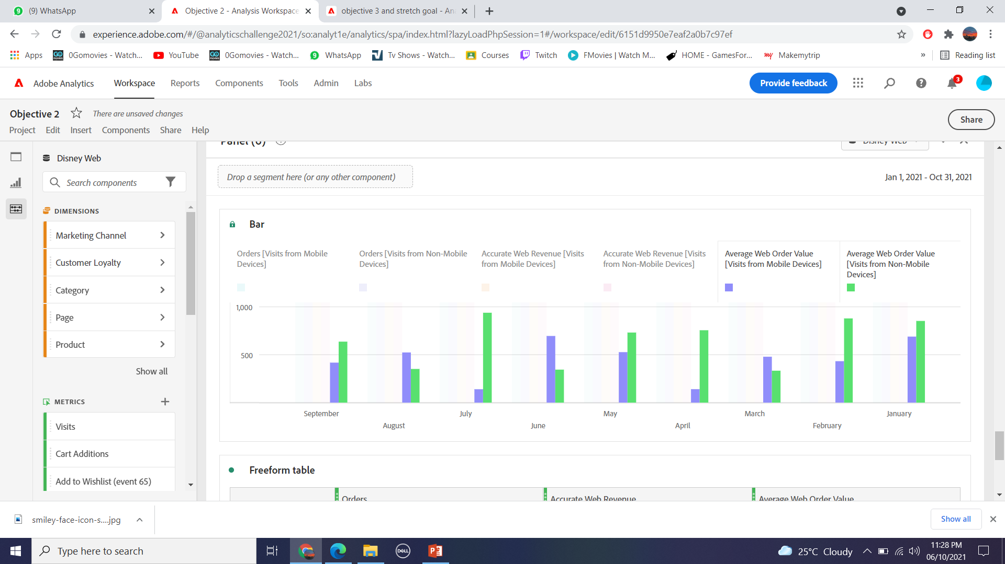
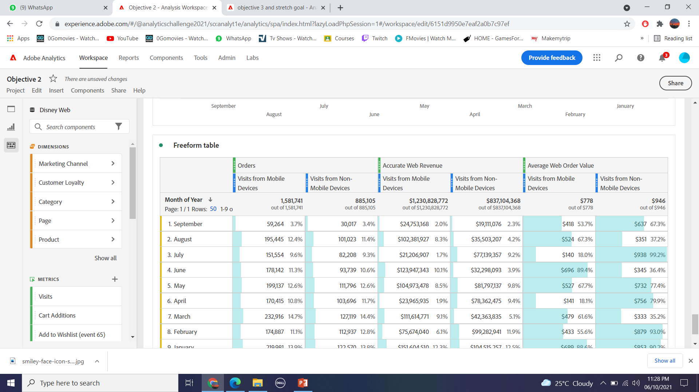

Slide 21
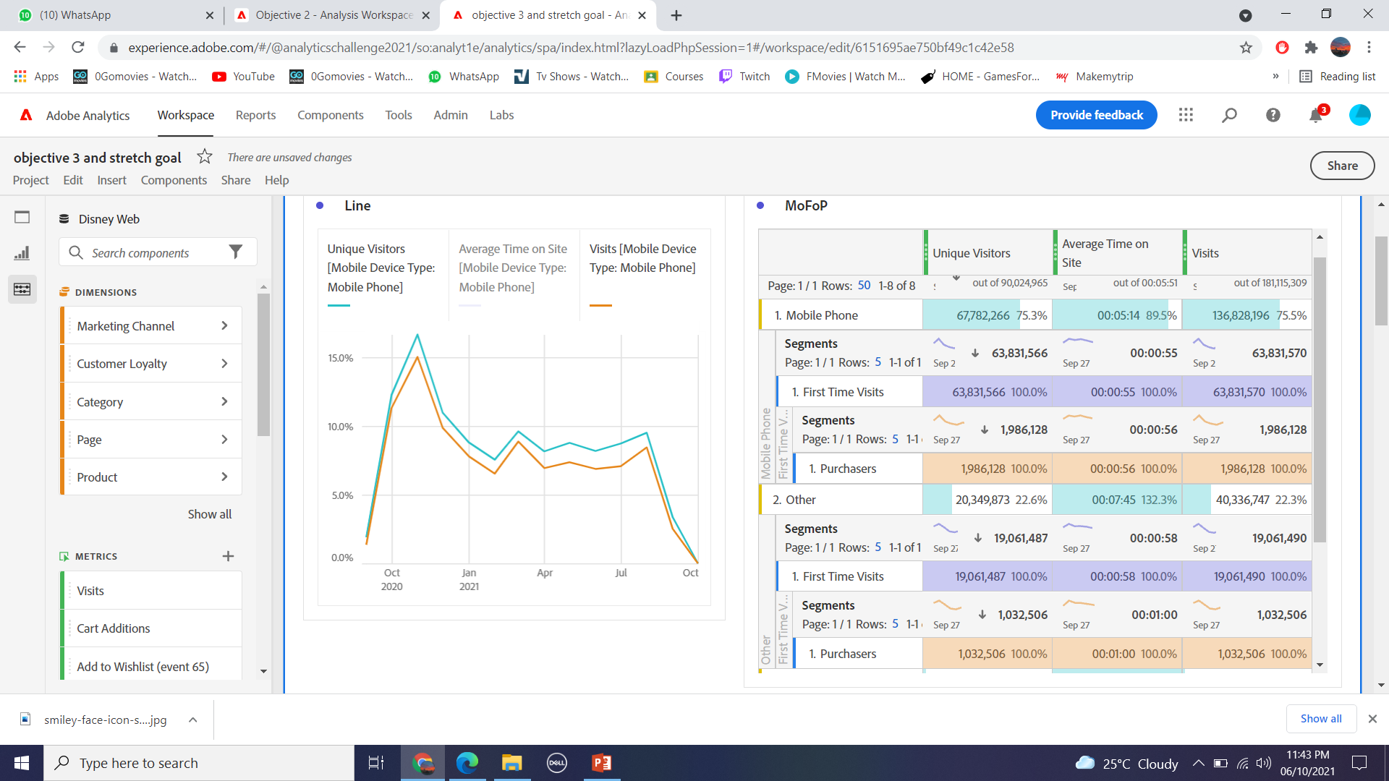
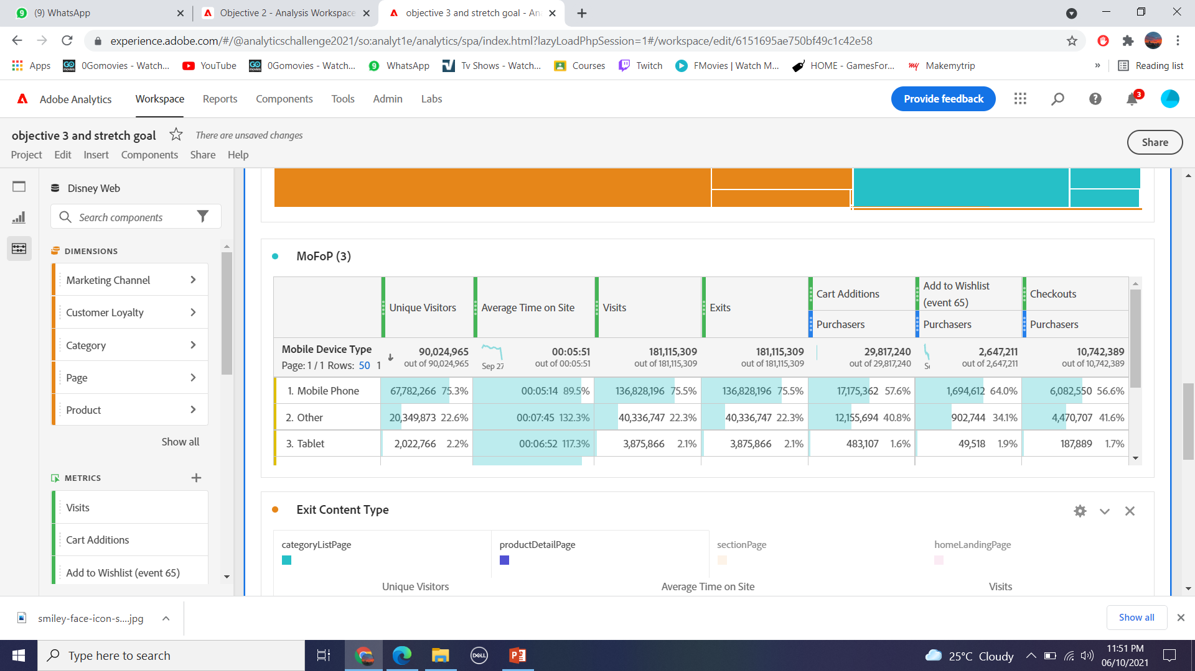
OBJECTIVE 3 DATA ANALYSIS

Slide 22
